Slide 1
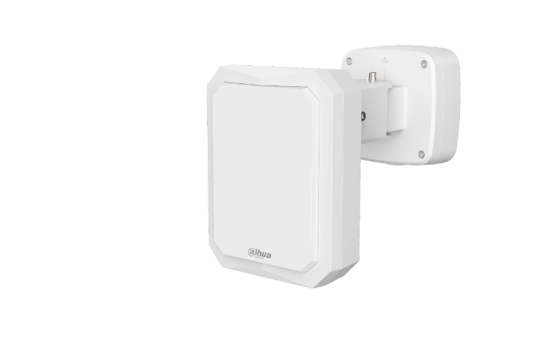
RADAR SECURITY
Accurately capture every movement
.
.
.
.
.
.
.
.
.
.
Dahua Technology
2019.12

Slide 2
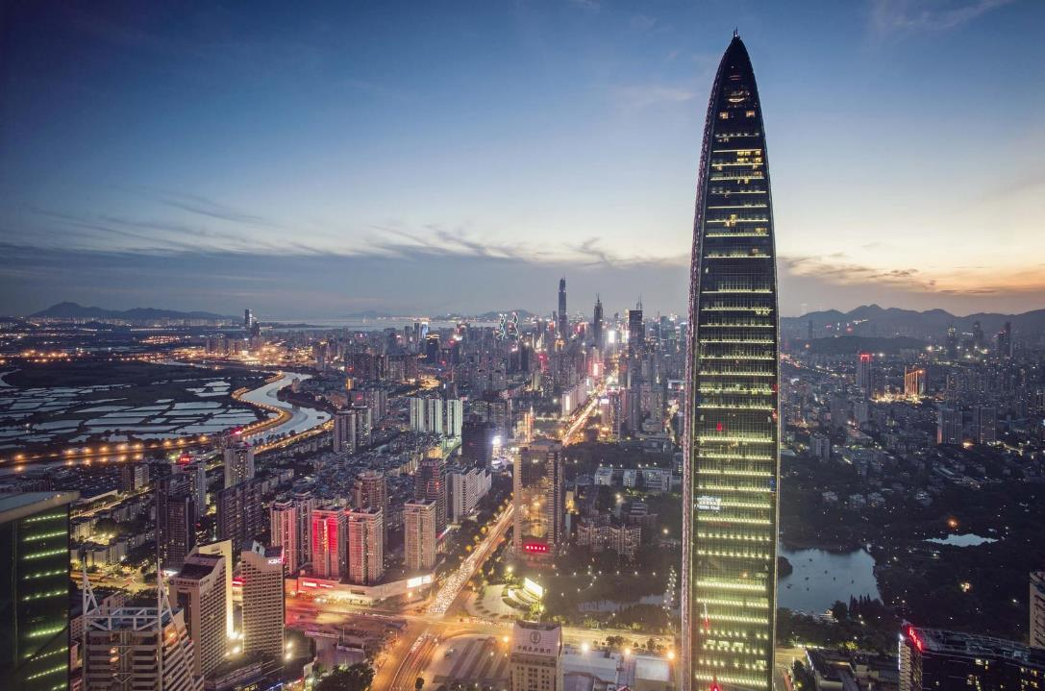
1
2
Product Introduction
Installation&Configuration
CONTENTS
Appearance, basic parameters, interface information, software platform, compatibility
Installation of required support, supportable PTZ access/platform and web configuration process
3
4
Highlight Demonstration
Solution&Application
Highlight function demonstration, real effect
Introduction of typical application schemes and recommendation of application scenarios

Slide 3
1.
Product Introduction
Appearance, basic parameters, interface information, software platform, compatibility

Slide 4
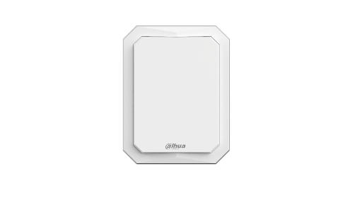
PFR4K-E50 | PFR4K-E120 | PFR4K-D300 | PFR4K-D450
Max. Target Number | 64 |  | 32
Detection Distance | 50m | Human: 120m Vehicle: 150m | Human: 300m Vehicle: 450m | Human: 450m Vehicle: 600m
Detection Angle | Horizontal: 120° Vertical: 36° | Horizontal: 120° Vertical: 26° | Horizontal: 90° Vertical: 13°
Max. Detection Speed | 40km/h, continuous trajectory |  | 80km/h, continuous trajectory
Min. Detection Speed | 0.17m/s, continuous trajectory |  | 0.5m/s, continuous trajectory
Distance Accuracy | ±1m | ±1.5m
Angle Accuracy | ±1°
Max. Area Number | 10
Modulation Type | FMCW
Scan Frequency | 10Hz |  | 8Hz
Operating Frequency | 24GHz
Detection Target Type | Human and vehicle
Detection Area(measured) | 2016㎡ | 13822㎡ | 70650㎡ | 147975㎡
Radar+PTZ Smart Tracking | Supported on web manager
Target Filtering | Support, human and vehicle filtering
Channel Selections | Support
Operating Temperature | -40℃~+70℃
Real-time interactivity | Radar controls PTZ directly, low delay
Casing | White, ADC12+PC
Dimensions | 204.9x157.9x67.1mm (8.07"x6.22"x2.64") |  | 244.9x184.9x61.2mm (9.64“x7.28“x2.41")
Weight | 1.7kg(2.2lb) |  | 2.0kg (4.41lb)
Product Introduction

Slide 5
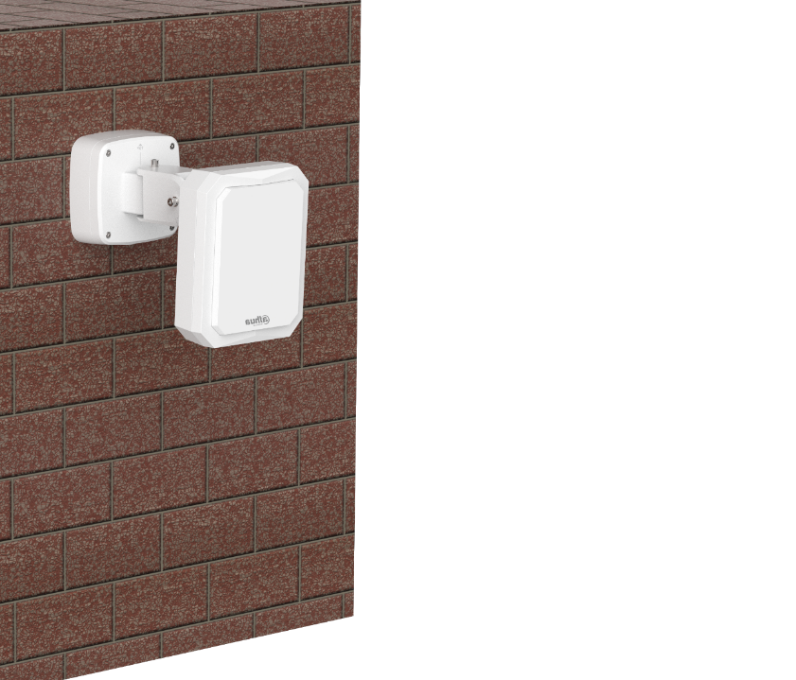
Key Features
PFR4K Series
24/7 DAY AND NIGHT
Working on all-weather conditions (darkness, heavy fog, rain, snow, etc.)
HIGH DETECTION ACCURACY
Low false alarm rate by adopting smart radar algorithm
Product Introduction
WIDE DETECTION RANGE
Horizontal 90/120-degree, extra wide angle detection range
.
.
.
.
.
ACTIVE TAREGR DETECTION
.
.
.
.
.
Moving track display, PTZ cameras real-time monitoring; Supporting human/vehicle target filtering
SMART FRONT-END CONTROL
IK09
Support to link multiple DAHUA PTZ cameras to one radar or multiple radars to one PTZ camera, graded alarm set
IP67
CENTRALIZED MANAGEMENT
Configuration and management on DSS platform for radar-PTZ smart tracking system

Slide 6
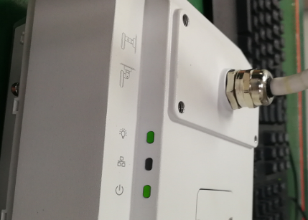
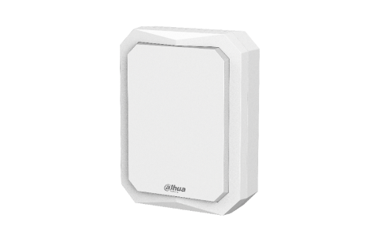
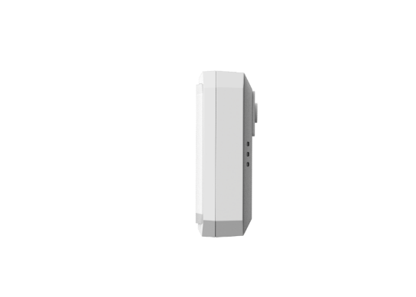
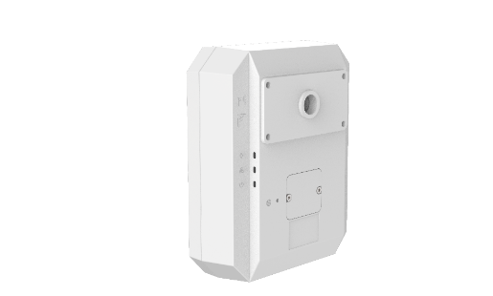
Product Introduction
Aesthetic design, strong appearance and simplicity of the design, generous
IP67, IK09 protection class, suitable for more outdoor environment
Function indicator light on the back for more convenient operation

Slide 7
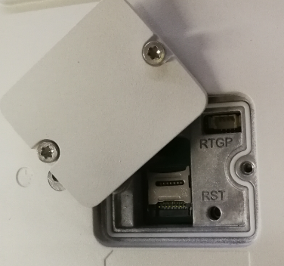
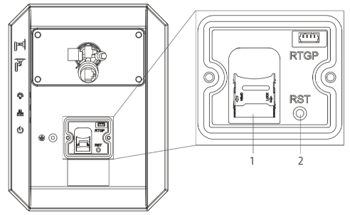
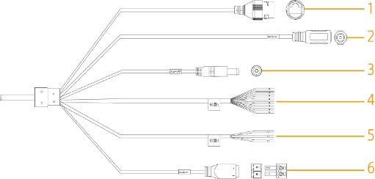
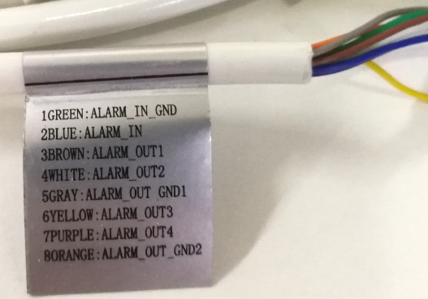
SD card slot:
Reset button
Product Introduction
1*RJ45: connect to a standard Ethernet cable, support POE power supply
1*Power input: DC12V (±30%)
1*Power out: DC12V, 0.165mA
(PFR4K-D does not support)
Alarm port: 1 input, 5 output
1*Power input: AC24V(±30%)

Slide 8
2.
Installation&Configuration
Installation of required support, supportable PTZ access/platform and web configuration process

Slide 9
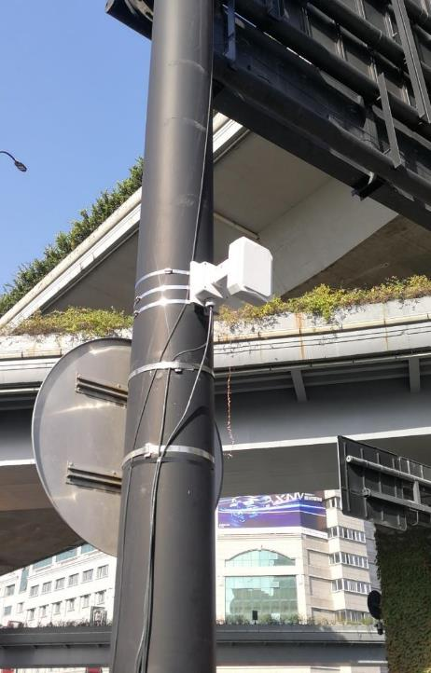
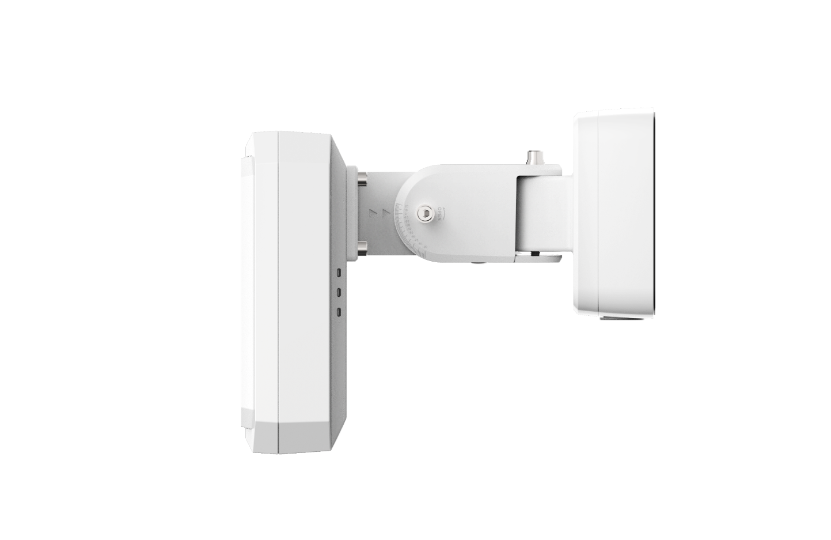
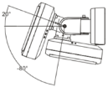
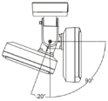
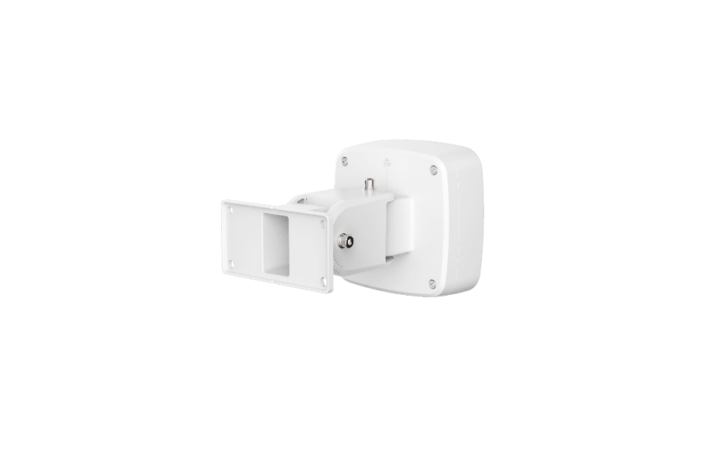
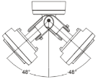
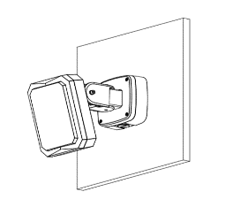
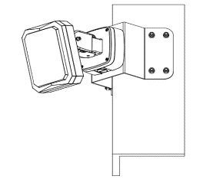
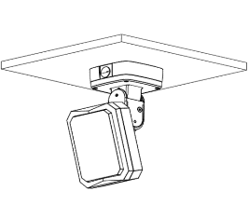
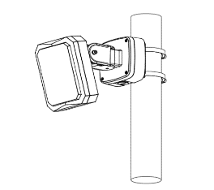
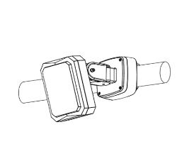
Installation Mode: PFB510W
For the installation application of single radar, we designed an integrated mounting bracket, which has junction function and supports vertical / horizontal multi-angle adjustment.
Easy to install
Pitch angles:
20° to -80°/-20° to 90°
Installation&Configuration
Horizontal angles:
-48° to 48°

Slide 10
Installation&Configuration
For more information, please refer to the installation video!

Slide 11
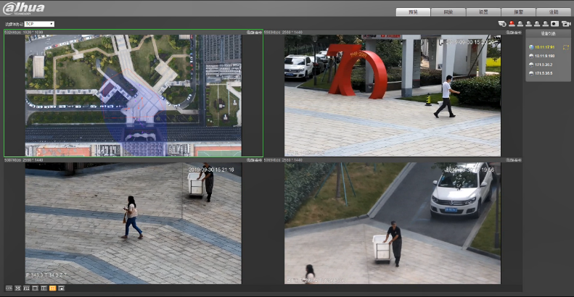
Configuration Mode
Linkage guide:
3.1 Import a map
3.2 Configure radar position
3.3 Configure radar calibration
3.4 Configure radar calibration(only for radar speed dome tracking system)
Region Management
Alarm (red)
Pre-warning (yellow)
Shield (green)
Login
(Modify IP address and configure other parameters as needed)
PTZ camera configuration
(only for radar PTZ tracking system)
1
2
3
4
Installation&Configuration
Smart Tracking

Slide 12
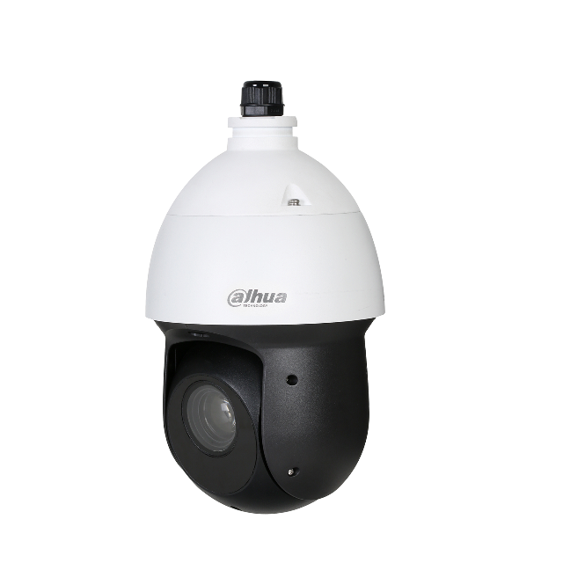
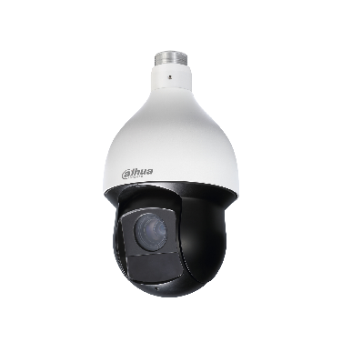
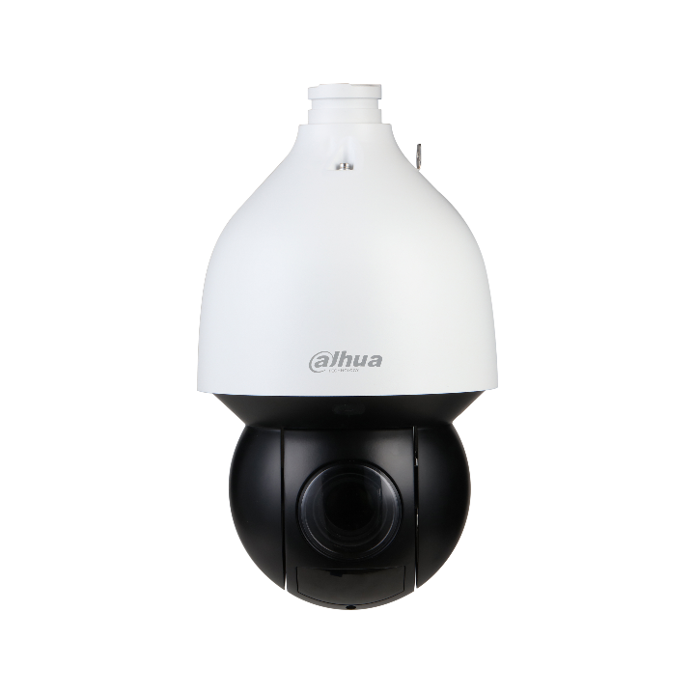
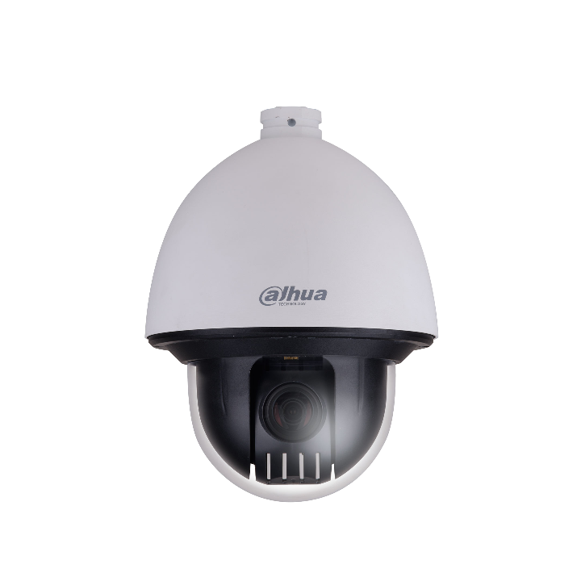
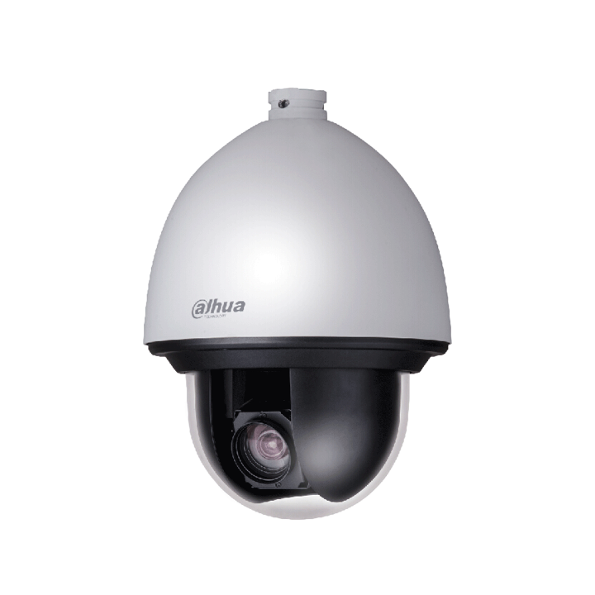
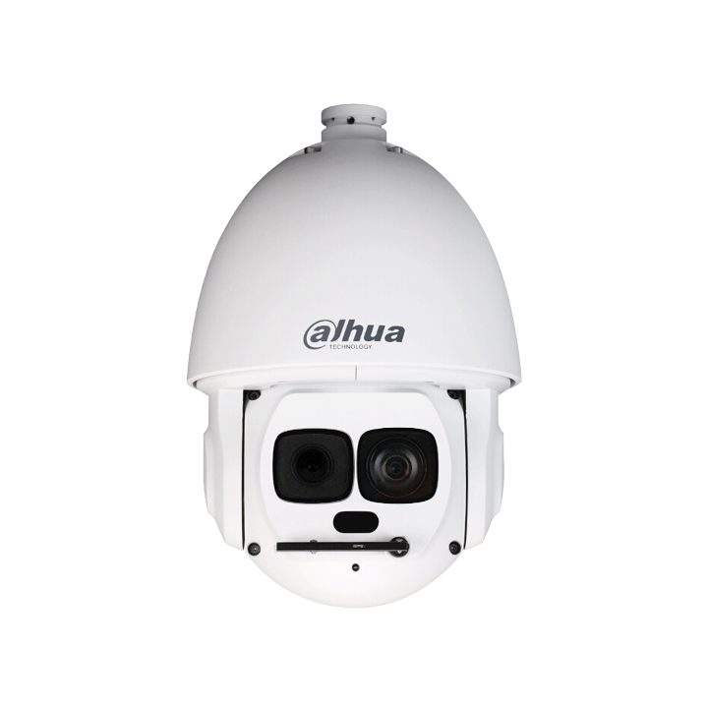
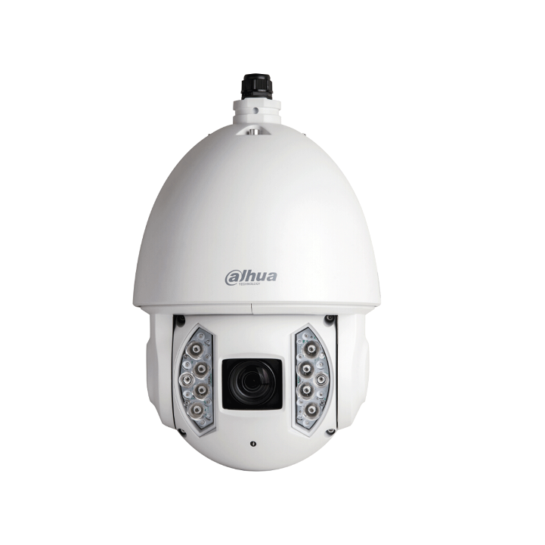
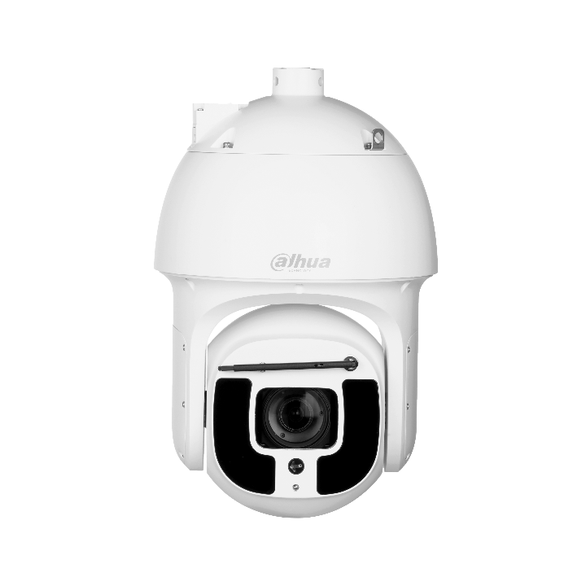
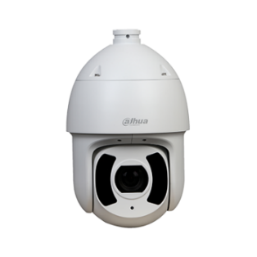
DH-PFRRK-E50/120
DH-PFR4K-D300/450
SD49425XB-HNR
SD49225XA-HNR
SD59430/59230/59225U-HNI
SD59232/432/425XA-HNR
SD5A425/445XA-HNR
SD6CE245/230/225U-HNI
SD6CE445XA-HNR
SD60430/230/225U-HNI
SD65F233XA-HNR
SD6AL245U-HNI(IR)
SD6AL233/445XA-HNR(IR)
SD6AL233XA-HNR(IR)
SD6AE233XA-HNI
SD8A840/440/240/820WA-HNF
SD8A840/440/240VI-HNI
SD10A248WA-HNF
PTZ83840-HNF-WA
PTZ19245U-IRB-N(-B)
PTZ1A225U-IRA-N
DAHUA radar is compatible with almost all DAHUA PTZ, and can be configured on the web and DSS Pro.
Compatibility
Notes:
这一页就是雷达所适配的球机列表，我已经全部写出来了，可以看到几乎囊括了所有的DAHUA球机，至于其他的相机例如热成像球机就需要定制了，以上信息可以作为参考。
This page is a list of the PTZ cameras that the radar is compatible with. I have written them all. You can see that almost all DAHUA PTZ cameras are included. As for other cameras such as thermal PTZ cameras, they need to be customized. The above information can be consulted.

Slide 13
3.
Highlight Demonstration
Highlight, function demonstration, real effect

Slide 14
Smart tracking
Target trajectory display and PTZ tracking, support multiple target tracking and multi-motion detection.

Slide 15
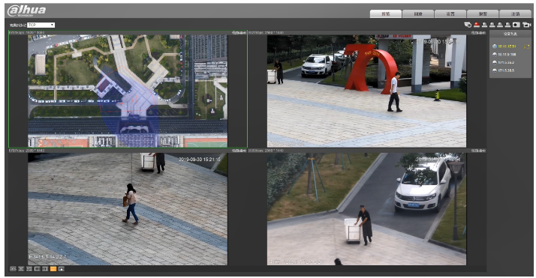
Radar with muti-PTZ linkage
Support multiple network PTZ cameras access, and achieve multi-target simultaneous monitoring and tracking.

Slide 16
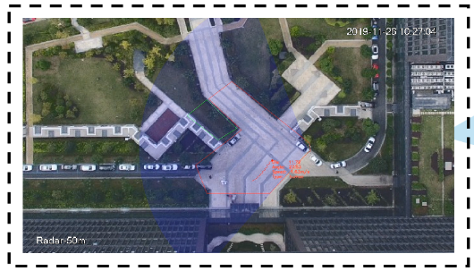
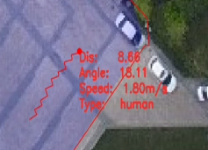
Video Metadata
Real-time display the distance and angle between dynamic target and radar, moving speed and identification of people and vehicles.

Slide 17
External equipment linkage
Support up to 5-channel alarm outputs, can allow the access of external devices of illuminator, horn and alarm to form an intelligent perimeter / area protection scheme.

Slide 18
4.
Solution&Application
Introduction of typical application schemes and recommendation of application scenarios.

Slide 19
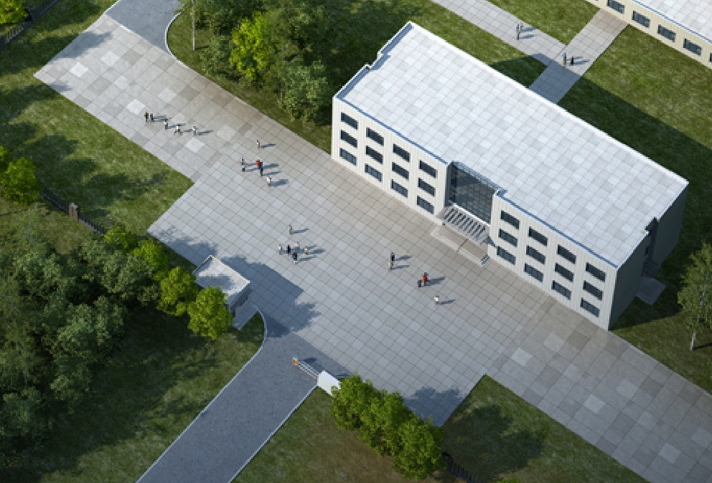
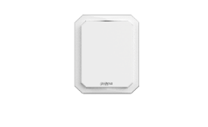
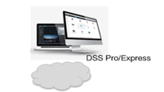
1
SOLUTION
Solution&Application
RADAR ONLY
When radar is used alone, as a detector, the intrusion trajectory of the object will be displayed in the detection area. If the corresponding functional area (defense area, alarm area, shielding area) is set up on the web or platform, the corresponding function will be realized. For different application scenarios, the necessary peripheral equipment——horn or illuminator will be added. It can display special functions such as sound and light alarm.
The single radar scheme is suitable for regional protection and perimeter protection.

Slide 20
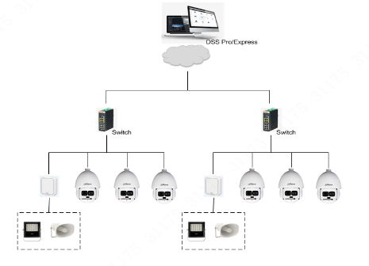
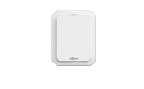
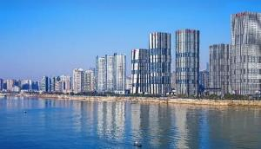
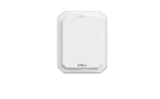
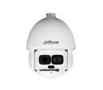
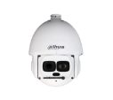
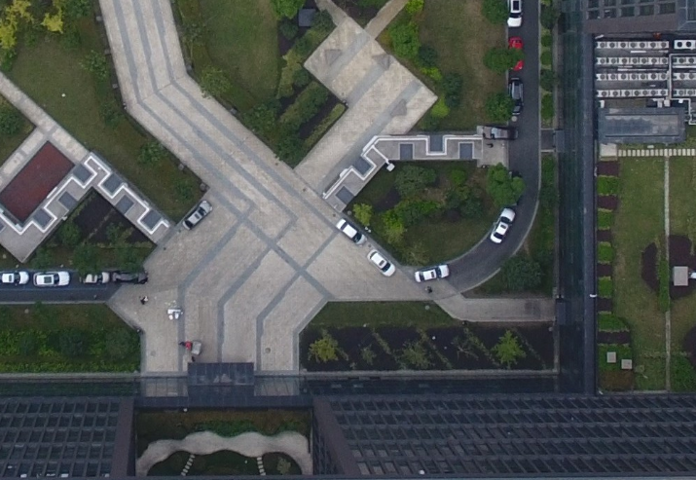
2
SOLUTION
……
Solution&Application
RADAR with MULTI-PTZ
The scheme of “one radar with multiple PTZ" is that multiple PTZ cameras can be invoked simultaneously in the defense area of a radar to carry out linkage tasks and realize specific business functions. Radar distributes control PTZ cameras according to different time and distance of target entering defense area, realizes PTZ cameras’ tracking and detail capture, and sets the alarm area or shielding area in defense area to realize special functions.
The scheme is very suitable for regional security protection, aiming at key areas, such as high-risk areas, high-value areas and private territories.

Slide 21
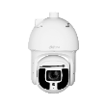
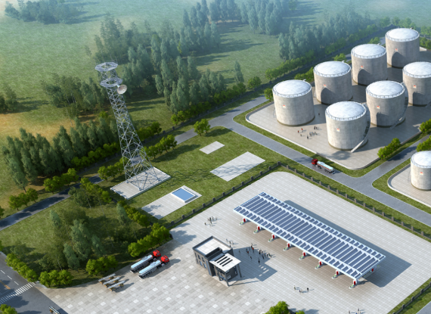
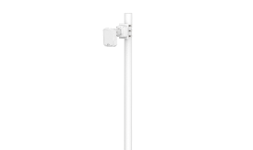
3
SOLUTION
MULTI-RADAR with ONE-PTZ
The detection range of single radar is 90-degree or 120-degree, three or four radars are integrated into a 360 degree detection, and a 360 degree regional protection solution is composed of three radars and one PTZ camera, which realizes efficient regional protection function for some specific scenarios.
Solution&Application
PFR4K-E
PFR4K-D
120°
90°
90°
120°
120°
90°
90°

Slide 22
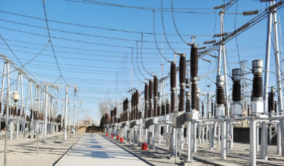
APPLICATION
High-risk areas
High-vale areas
Upscale private areas
Solution&Application
Explosion fields/Transformer substation
Chemical warehouse/Parking lots/Airport
Upscale Park/ Private Beach Resort

Slide 23
THANKS
More than that
https://www.dahuasecurity.com/

